Slide 1
MSDS670_X40_Data Visualization Regis University
Week 8 Final Project
Ilse Severance

Slide 2
Introduction
This study aims to address the question: Where, when, and why do wildfires occur globally, and how do their intensity patterns vary across regions, seasons, and meteorological conditions?
Between 2024 and 2025, satellites detected over 15,500 wildfire hotspots across seven fire prone regions. Preliminary analysis indicates high-risk areas in Central Africa, India, Southeast Asia, and northern Australia, moderate activity in the U.S., southern Africa, and parts of South America, and lower activity in Europe, northern Asia, and North America. By examining these spatial, temporal, and environmental patterns, the study aims to inform national-level assessments, seasonal planning, and meteorological risk for more effective wildfire management.

Slide 3
Methodology
Data Collection
All data in this study were collected from Kaggle.
Fire hotspot data were derived from satellite sensors (MODIS and VIIRS).
Meteorological variables include maximum temperature (°C), wind speed (km/h), precipitation (mm), and relative humidity (%).
Spatial coverage: Seven fire prone regions across 35 countries, spanning January 2024 to December 2025
Analysis Techniques
Global Fire Density Heatmap: We aim to visualize the spatial concentration of fire intensity worldwide.
Top 10 Country Bar Chart: We aim to compare fire activity at the national level and highlight the most affected countries.
Temporal and Seasonal Heatmaps: We aim to identify trends in fire activity across months and seasons.
KDE Distributions of Meteorological Variables: We aim to examine how temperature, humidity, wind, and precipitation influence fire intensity.

Slide 4
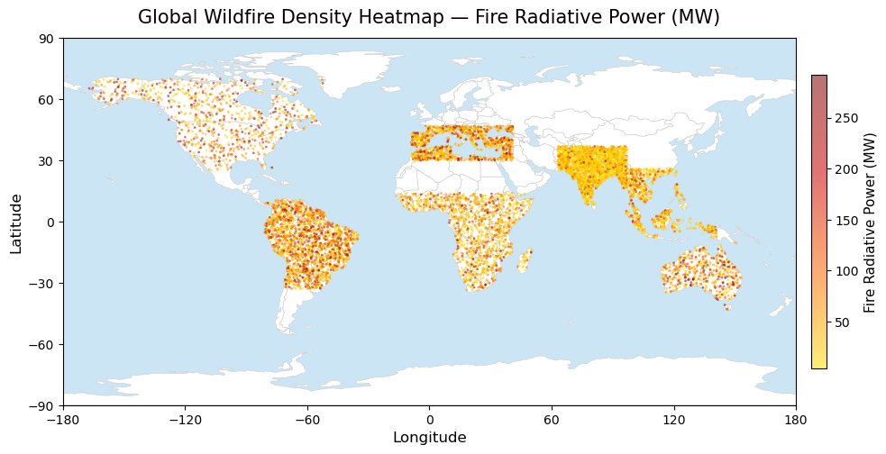
Global Hotspot Distribution
High intensity hotspots: Central Africa, India, Southeast Asia, northern Australia, intense fires from seasonal burning, agriculture, and dry periods.
Moderate regions: Western/central U.S., southern Africa, parts of South America, frequent but less intense fires.
Low activity: Europe, northern Asia/North America, Middle East, minimal fires due to cooler climates or strong fire management.

Slide 5
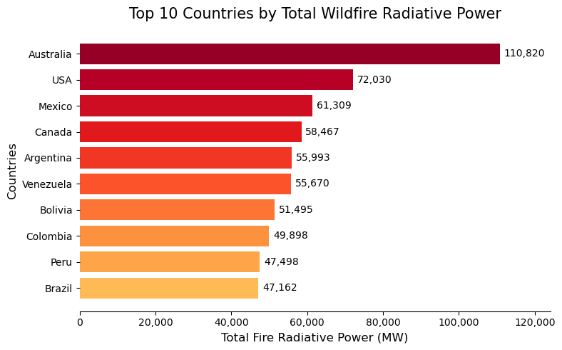
Top 10 Countries by Total Wildfire Radiative Power
Australia leads globally, followed by the United States, indicating exceptionally intense and widespread fire activity in these countries.
Mid tier cluster (Mexico, Canada, Argentina, Venezuela, Bolivia) reflects sustained fire seasons with significant biomass consumption.
Colombia, Peru, and Brazil round out the top ten, showing notable fire activity due to agricultural expansion and deforestation.

Slide 6
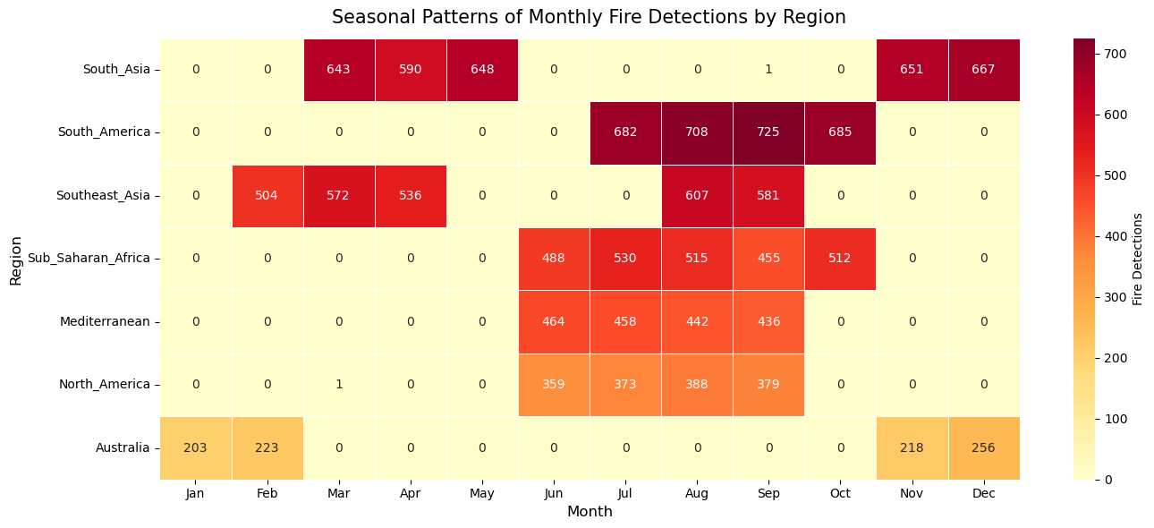
Seasonal Patterns of Monthly Fire Detection by Region
Wildfire occurrence closely follows distinct regional climatic and seasonal patterns.
Peaks align with hemispheric and regional climate cycles
These temporal trends highlight the importance of incorporating localized, seasonally aware strategies in fire risk forecasting, resource allocation, and disaster preparedness to improve mitigation and response effectiveness.

Slide 7
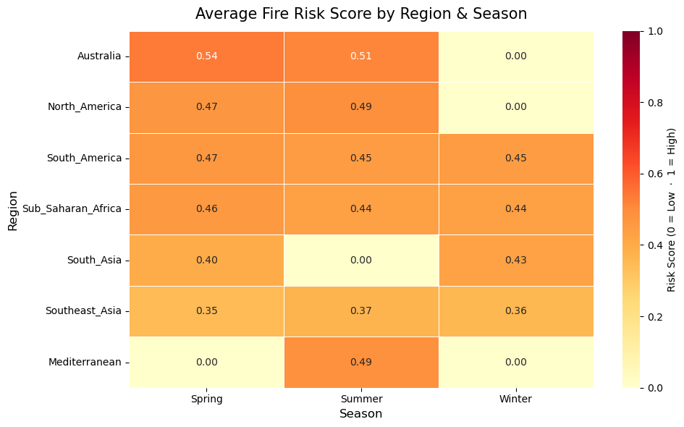
Regional Variation in Average Seasonal Wildfire Risk
Summer peaks fire risk in most regions, especially North America and the Mediterranean.
Australia shows highest risk in Spring & Summer.
South America & Sub-Saharan Africa have steady year-round risk.
Winter risk is minimal across regions.
Fire risk aligns with regional climates, not global cycles.

Slide 8
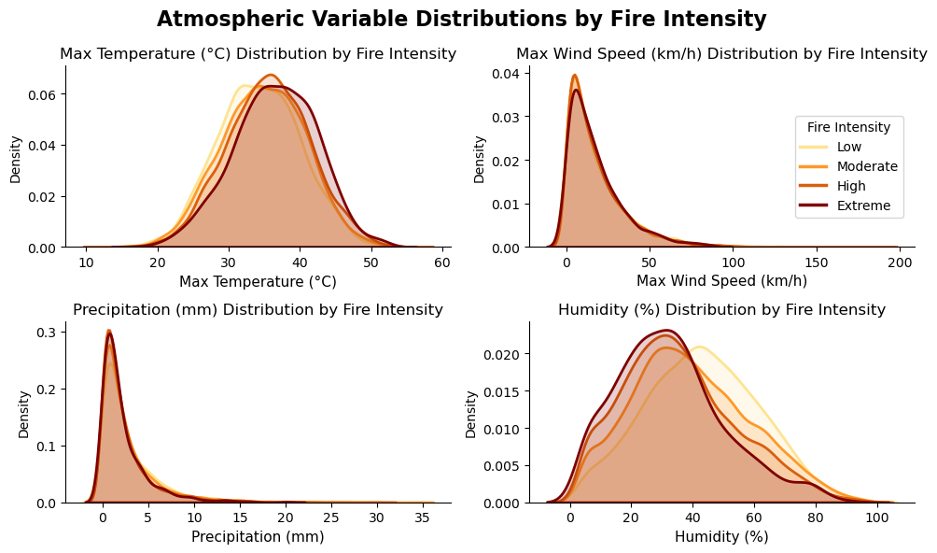
Atmospheric Variable Distributions by Fire Intensity
The distribution plots indicate that high temperatures and low humidity are the most distinguishing atmospheric factors associated with extreme wildfire intensity.
Wind acts as a compounding factor, increasing fire spread and severity.
Precipitation appears necessary for fire suppression, but its effect is harder to detect if the timing of the rain is not being considered.

Slide 9
Conclusions
During this analysis, we found that wildfire risk is highest in tropical and subtropical regions, with seasonal peaks creating critical operational hotspots. Australia, the U.S., Central Africa, India, and Southeast Asia experienced the most intense fire activity, while Europe, northern Asia, and North America showed lower exposure.
At the national level, Australia and the U.S. lead in fire intensity, with several South American countries emerging as hotspots due to agricultural expansion and deforestation.
The data also shows that high temperatures, low humidity, strong winds, and limited precipitation are key drivers of fire severity. These insights support predictive modeling, early warning systems, and more effective resource deployment.
By integrating spatial, seasonal, and meteorological data, organizations can make data-driven decisions to mitigate wildfire risk and improve operational planning.

